Slide 1

PL/SQL Capstone Project: Smart Shopping System
This presentation details the development of Smart Shopping System undertaken as a capstone project for the Database Development course (INSY 8311). The main purpose of this project is automate and secure retail checkout processes using Oracle database. The project encompasses various stages, from initial problem definition and business process modeling to database creation, advanced programming, and auditing functionalities. The following slides will provide an overview of each step, highlighting the key components, design decisions, and outcomes of the project.
by MANZI Ephrem, 27856
INSTRUCTOR: MANIRAGUHA Eric
PL/SQL 2025

Slide 2

1. Problem Statement
THE PROBLEM
Context: BIG SUPERMARKETS
This system is designed for busy big supermarkets like simba and sawa citi. Where these stores rely on manual checkout counters where a cashier scans every item when customers are standing on line waiting
The current manual system has major issues:
Long Waiting Times: Customers waste significant time standing in queues just to pay. This leads to frustration and sometimes abandoned carts (customers leaving without buying).
Objective: Automation and Accuracy
The Problem I am solving is the inefficiency of manual checkout lines, which causes long queues, data delays, and human errors.".
Instead of a cashier scanning items one by one, the system processes the entire cart, calculates the total, and records the payment in a single click (using PL/SQL Stored Procedures).

Slide 3
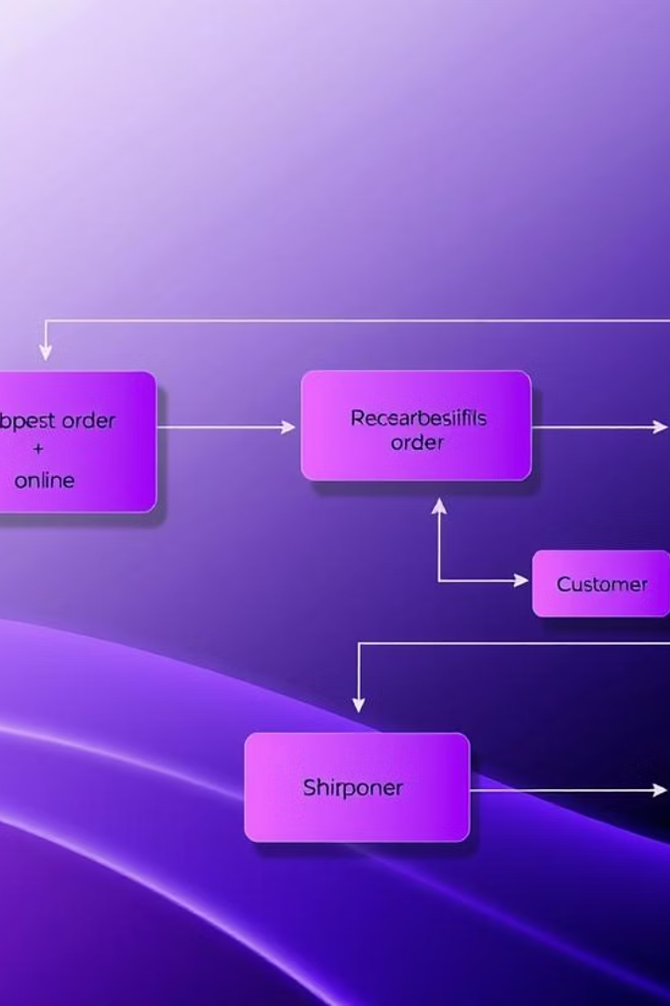
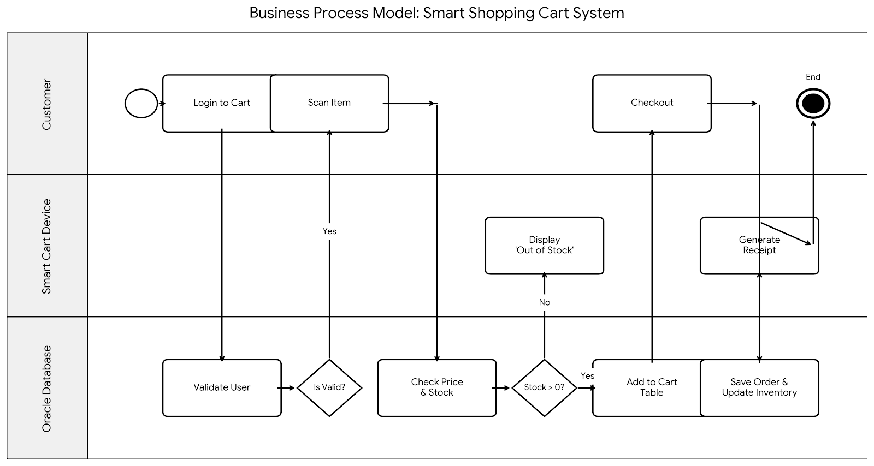
2. Business Process Modeling
Process Modeled
Entities
MIS Role
The Business Process Model (BPM) illustrates the workflow of the Smart Shopping Cart System. It visualizes the interactions between three key actors: the Customer, the Smart Cart System and Oracle Database .
Key entities involved are Products, Users, Orders, Cart and Payments. Each entity has specific attributes and relationships defined to ensure comprehensive data representation. The model captures the interactions between these entities to manage inventory efficiently.
This process demonstrates key Management Information System (MIS) principles by automating data entry (scanning), ensuring data integrity (real-time stock checks), and providing immediate information for decision-making (inventory updates).
Business Process Model and Notation (BPMN) with swimlanes in draw.io/Lucidchart ensures a clear representation.
PL/SQL @2025
PL/SQL @2025

Slide 4
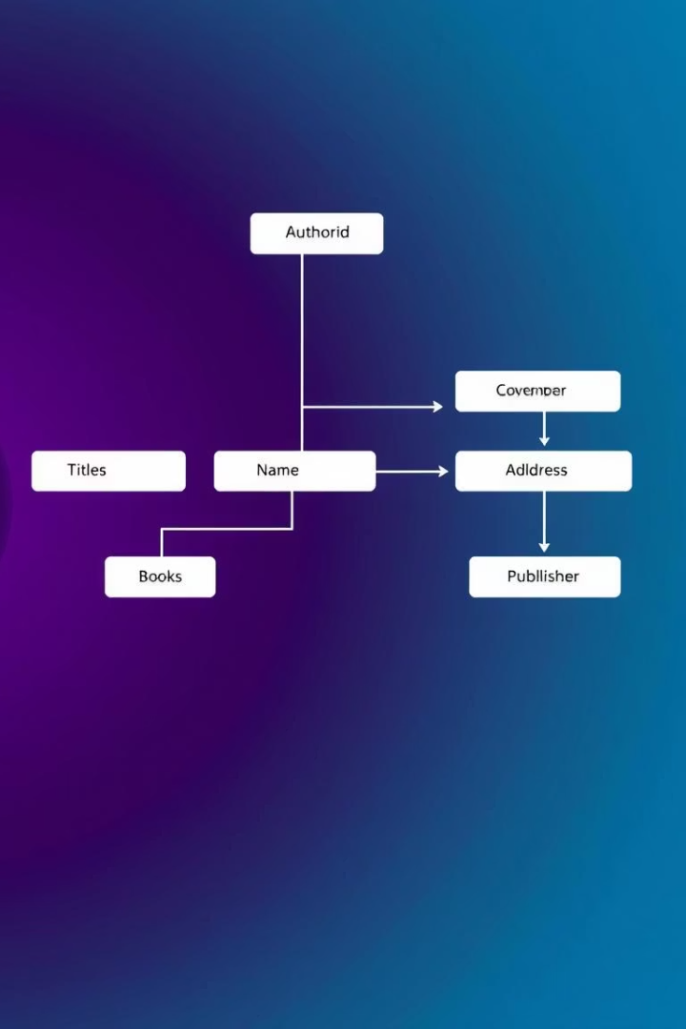
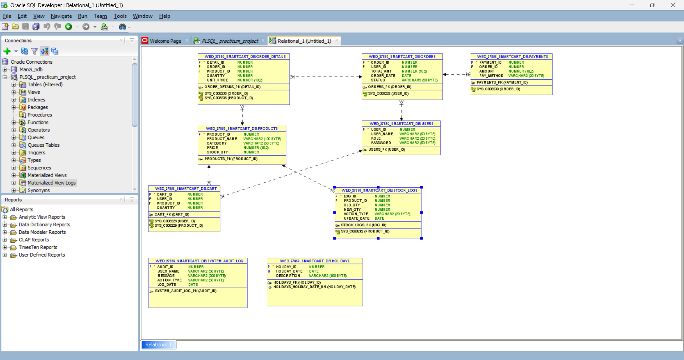




3. Logical Model Design
Entities
Relationships
Normalization
Core entities include Products, Users, Orders, and Order_details and Cart. Each entity is designed to capture essential data, enabling efficient tracking and management of inventory.
One-to-many relationships are established using Foreign Key (FK) constraints to ensure data integrity and proper linkages between entities. This design supports efficient data retrieval and reporting.
The database adheres to the Third Normal Form (3NF) to eliminate data redundancy and ensure data consistency. This improves storage efficiency and reduces the risk of data anomalies.
Constraints
Primary Key (PK), Foreign Key (FK), NOT NULL, and CHECK constraints are implemented to enforce data integrity and business rules. These constraints ensure data quality and prevent invalid entries.
PL/SQL @2025

Slide 6
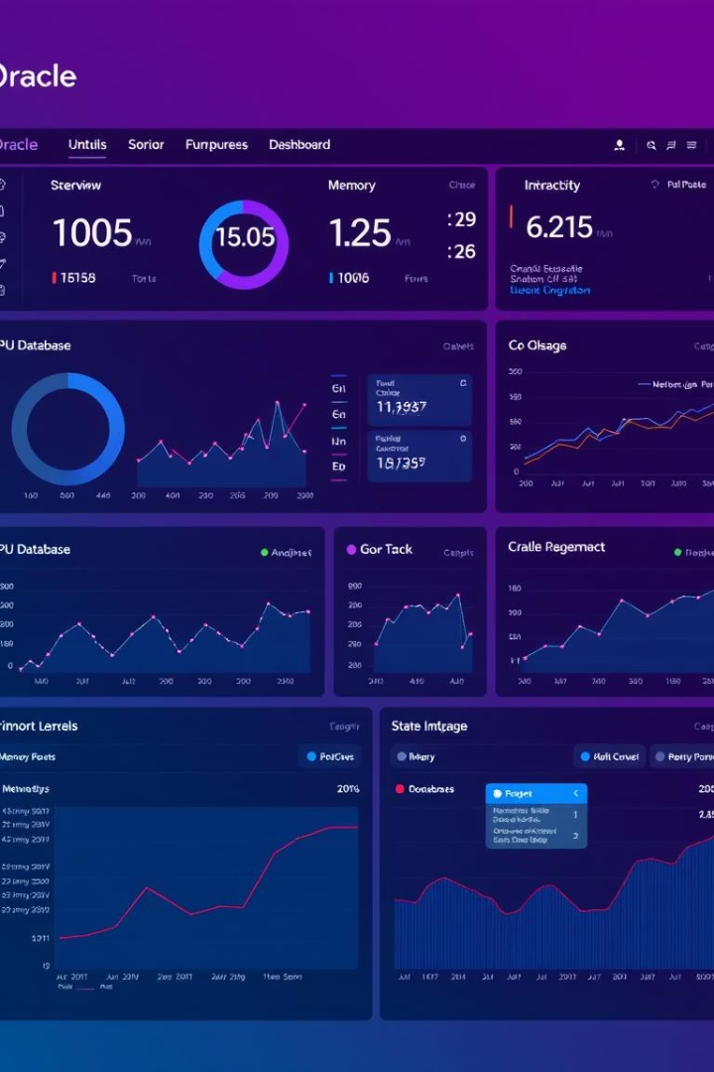
4. Database Creation
1
Database Setup
The database was created using Oracle, following a consistent naming standard for tables, columns, and constraints. This ensures uniformity and ease of maintenance.
2
Admin Privileges
Super admin privileges were configured to ensure full control and management of the database, including user access and security settings. This is essential for maintaining data integrity and security.
3
Monitoring
Oracle Enterprise Manager (OEM) was utilized for real-time monitoring of database performance, resource usage, and potential issues. This enables proactive management and ensures optimal performance.
4
Evidence
Screenshots providing evidence of the database creation process and configuration settings are included in the project repository on GitHub. This validates the setup and configuration steps.
PL/SQL @2025

Slide 7
5. Tables & Sample Data
Table Creation
1
Tables were created directly from the Entity Relationship Diagram (ERD) to ensure accurate representation of entities and relationships within the database.
Data Types & Constraints
2
Precise data types, constraints, and keys were defined for each table column to enforce data integrity and consistency, aligning with the logical model design.
Sample Data Insertion
3
Realistic sample data was inserted into each table to simulate real-world operations and test the functionality of the database and related procedures.
Comprehensive indexing was implemented to optimize query performance and ensure rapid data retrieval.
PL/SQL @2025

Slide 8
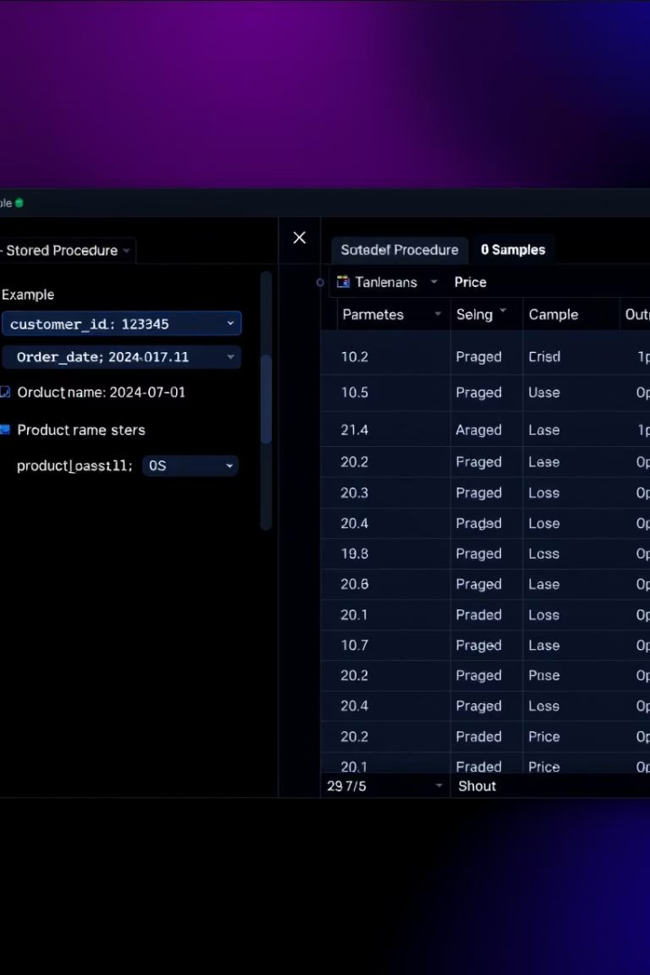




6. Interaction & Transactions
DML/DDL Operations
Data Manipulation Language (DML) and Data Definition Language (DDL) operations, including Insert, Update, and Create statements, were implemented to manage data within the database.
Procedures
Stored procedures were created with parameters and exception handling to ensure robust and reliable data processing, managing potential errors gracefully.
Functions and Cursors
Functions and cursors were employed to perform complex data manipulations and calculations, enabling efficient data retrieval and processing.
Window Functions
Window functions were applied for advanced analytics, such as ranking and trend analysis, providing valuable insights into inventory data.
PL/SQL @2025

Slide 9
7. Advanced Programming & Auditing
Triggers
Packages
Audit Logging
Triggers were implemented to prevent unauthorized data manipulation during weekdays and holidays, ensuring data integrity and compliance with business rules.
Packages were utilized to encapsulate restriction logic, providing a modular and maintainable approach to enforcing business rules and data constraints.
A comprehensive audit log was created to capture user actions, including the user ID, timestamp, action performed, and status (Allowed/Denied), ensuring full auditability.
PL/SQL @2025

Slide 10




8. Results & Demonstration
Successful Interaction
Query Validation
Confirmed successful interaction with the database, validating that all components function as expected and data can be retrieved and manipulated effectively.
Query results were thoroughly tested and validated to ensure data accuracy and reliability, confirming that the database provides correct and meaningful information.
1
2
Project Code
SQL Scripts
Complete project code, along with detailed documentation and configuration instructions, is available on GitHub, facilitating replication and further development.
4
All SQL scripts used for database creation, table design, and data manipulation are included in the GitHub repository, providing a complete record of the project.
3
PL/SQL @2025

Slide 11



9. Conclusion & Future Work
1
Automated Processes
2
Auditability
3
Data Security
Achievements include automated inventory processes, auditability and data security. Future enhancements include adding intuitive dashboards for real-time visualization of inventory data, developing a mobile interface for on-the-go management, and incorporating predictive analytics to forecast stock demand accurately.
PL/SQL @2025

